Slide 1

Capstone Project Mobile Price Range Prediction
Team Members Chetan Patil
Mrunal Badgujar
Sachin Chaudhari
Rajesh Patil

Slide 2

PROBLEM DESCRIPTION:
In the competitive mobile phone market companies want to understand sales data of mobile phones and factors which drive the prices. The objective is to find out some relation between features of a mobile phone (e.g.: - RAM, Internal Memory, etc.) and its selling price. In this problem, we do not have to predict the actual price but a price range indicating how high the price is.

Slide 3
Points To Discuss
Data Description And Summary
Exploratory Data Analysis
Heat Map
Machine Learning Algorithms
Logistic regression
Decision tree
Random forest classifier
Gradient Boosting Classifier
K Nearest Neighbour
XGBooster
Support Vector Machine (SVM)
Conclusion

Slide 4
Data Summary:
The dataset contains mobile features information (Battery power, Bluetooth, Dual sim, Front camera, Internal Memory, Mobile depth, Number of Cores, Primary camera etc) . By using these features we have to predict the mobile price range means mobile range from 0 to 3.
Data Description:
Battery_power - Total energy a battery can store in one time measured in mAh
Blue - Has bluetooth or not
Clock_speed - speed at which microprocessor executes instructions
Dual_sim - Has dual sim support or not
Fc - Front Camera mega pixels
Four_g - Has 4G or not
Int_memory - Internal Memory in Gigabytes
M_dep - Mobile Depth in cm
Mobile_wt - Weight of mobile phone
N_cores - Number of cores of processor
Pc - Primary Camera mega pixels

Slide 5
Data Description (Continuous)
Px_height - Pixel Resolution Height
Px_width - Pixel Resolution Width
Ram - Random Access Memory in Mega Bytes
Sc_h - Screen Height of mobile in cm
Sc_w - Screen Width of mobile in cm
Talk_time - longest time that a single battery charge will last when you are
Three_g - Has 3G or not
Touch_screen - Has touch screen or not
Wifi - Has wifi or not
Price_range - This is the target variable with value of
0(low cost),
1(medium cost),
2(high cost) and
3(very high cost).
Thus our target variable has 4 categories so basically it is a Multiclass classification problem.

Slide 6
Exploratory Data Analysis

Slide 7
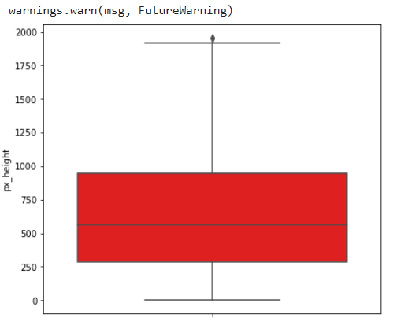
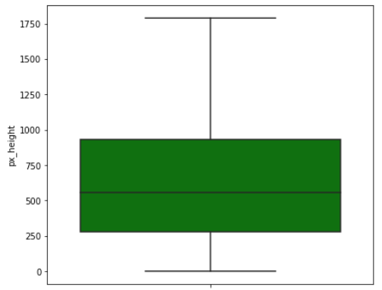
Pre-Processing
There is a need for data pre-processing because the data may be incomplete or inconsistent or noisy. There are many ways to deal with un-processed data viz:
Data Cleaning:
By this term we mean filling in the missing values in data, identifying and removing outliers in the data, smoothening filling.
We observed that sc_width and px_height have a minimum value 0. which is not possible on any mobile. We dropped the column
We can see the outliers present in our data need to clean data outliers removed by IQR method
As we can see outliers are removed from our data so it will give us normalised data and easy to predict the prediction.

Slide 8
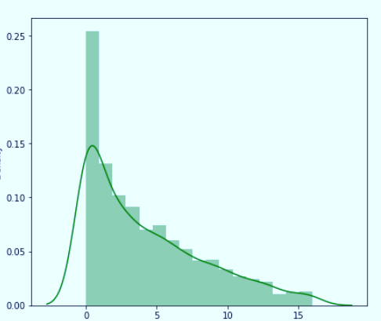
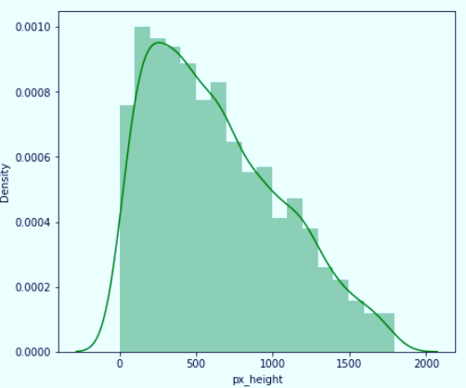
Data Transformation:
In this stage operations like normalization and aggregation are performed.
As we checked our dataset is rightly skewed so need to normalise it
Normalised the dataset.

Slide 9
Exploratory Data Analysis

Slide 10
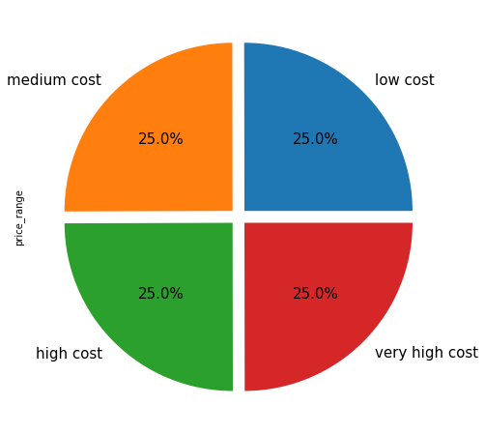
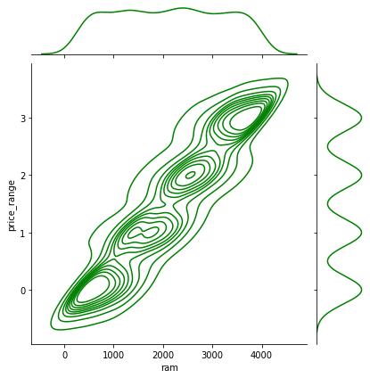
Let’s see the analysis by using data visualization
Checking Data Balance or Imbalance
RAM EFFECT ON PRICE
Observation: We can see that our target variable is equally distributed.
Observation: As Ram size increases price also increase in mobile.

Slide 11
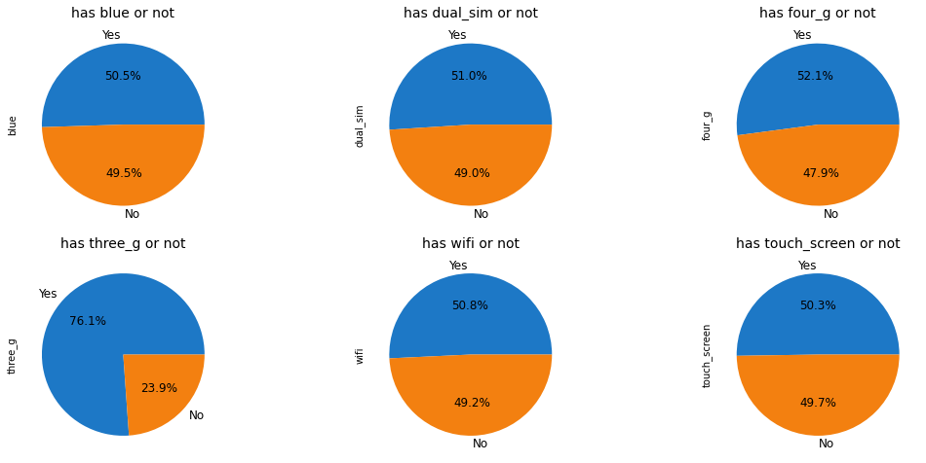
Binary categorical variables
Observation:
1 means it has the specifications.
0 means it does not have the specifications.
Percentage Distribution of Mobiles having Bluetooth, dual sim, 4G,wifi and touchscreen are almost 50%
Very few mobiles (23.8%) do not have Three_g.

Slide 12
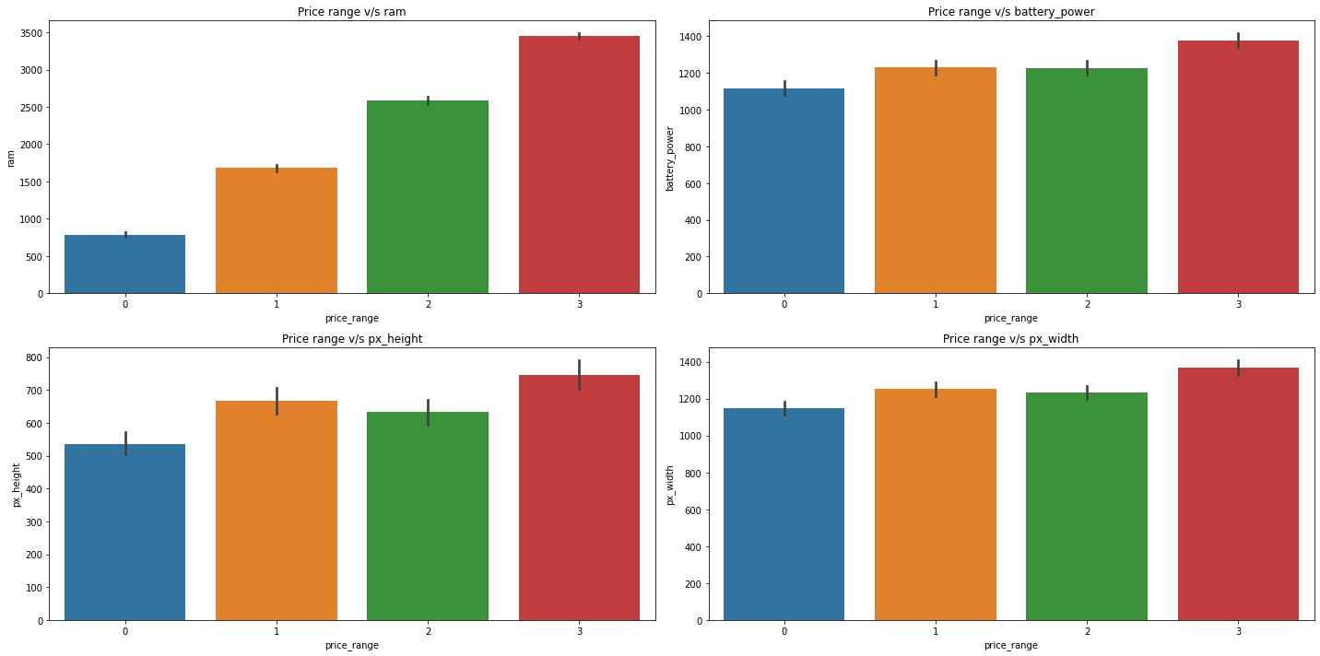
Price Range Vs Other Features
Observations:
Mobiles having RAM more than 3000MB falls under the Very high-cost category. As RAM increases, the price range also increases.
Mobiles having RAM less than 1000 MB falls under the low-cost category.
Mobiles with battery power more than 1300 mAh have a very high cost. And Mobiles with battery power between 1200 and 1300 mAH falls under medium and high-cost category.
Mobiles with more than 700-pixel height and width more than 1300 have very high cost.

Slide 13
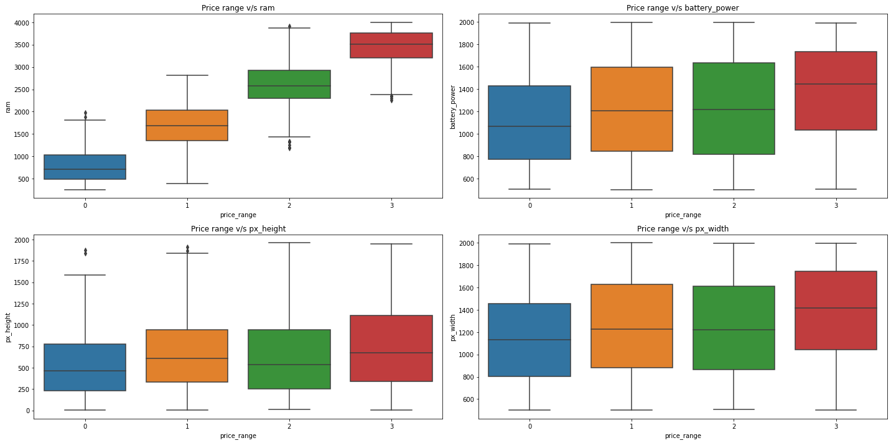
Box Plot Price Vs Other Features
Observation: Ram has the strongest positive correlation with price range.

Slide 14
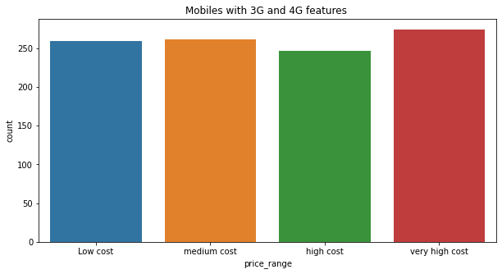
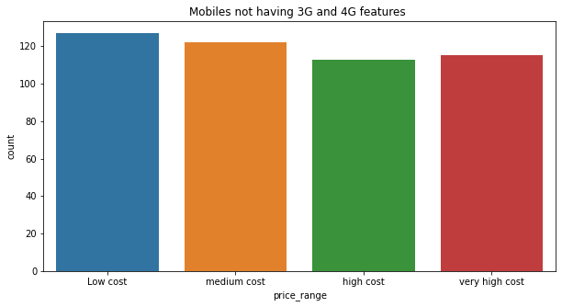
Mobiles with both 3G and 4G.
Mobiles not having no 3G and 4G.
Observation: As we can see from low cost to very high-cost mobiles have both features.
Observation:
It’s very obvious that low-cost mobiles will not have 3G and 4G.
Mobiles with very high cost may have 5G. As we know, technology changes every time.

Slide 15
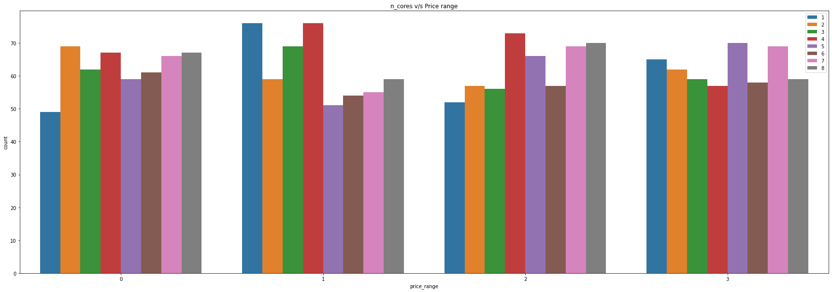
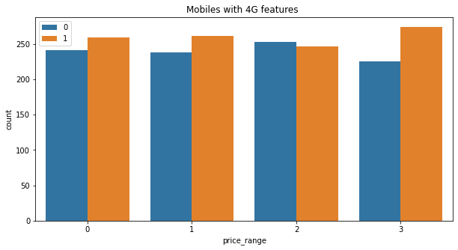
n_cores v/s price range
Mobile with 4G Features
Observations:
Price range 0 has majority of phones with 2 core processors
Price range 1 has majority of phones with 1 and 4 core processors
Price range 2 has majority of phones with 4 core processors
Price range 3 has majority of phones with 5 and 7 core processors
Observation
Majority of phones of only price range 2 dont have 4G service.

Slide 16
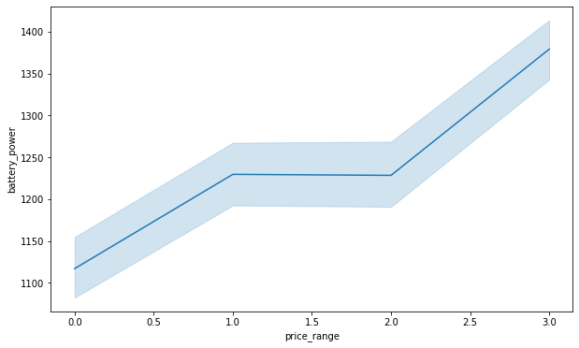
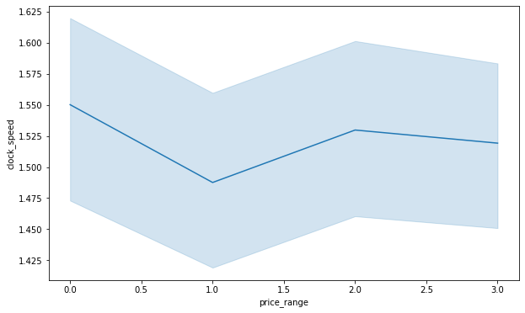
Let's Check which numerical feature is driving the price range most
As we can see in the above graph the relationship between price and battery power is positive,As battery power incereases price also increases. But in ranges 1 and 2, price is stable, meaning battery size has no effect on price.
As per the graph, we see the clock speed not much affecting the price, but in the range of 1 is affected by clock speed.

Slide 17
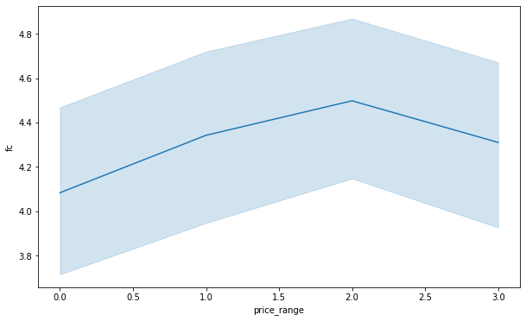
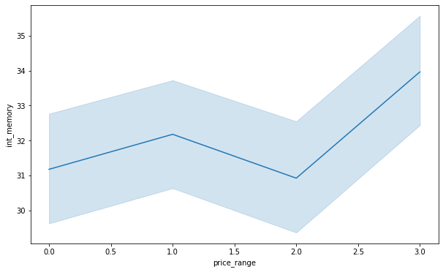
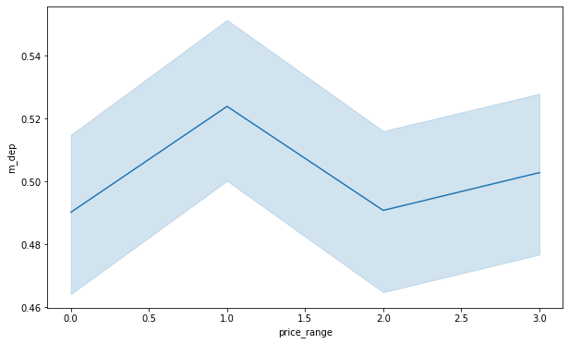
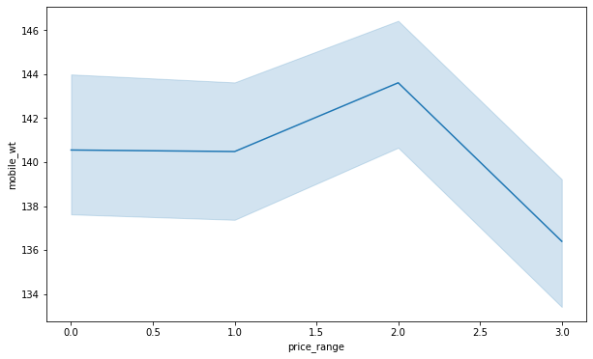
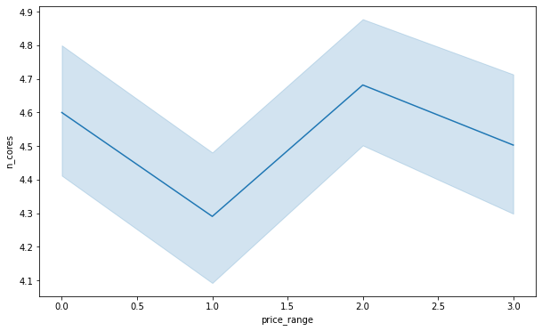
Let's Check Which Numerical Feature Is Driving The Price Range Most
As per the graph we see the front camera affecting the price in range o to 2 but not to range 3 mobiles
Internal memory features affecting range 0 and 1 but not range 2 and range 3 are also affected by int memory.
Range 1 and 3 is affected by mobile depth
Range 2 mobiles mostly affected by mobile width
Range 0 and range 2 mobiles price affected by number of cores.

Slide 18
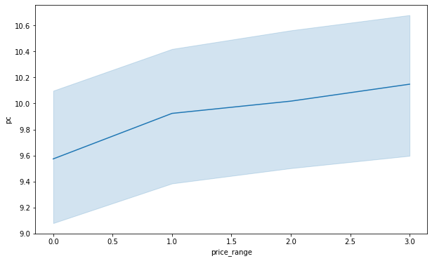
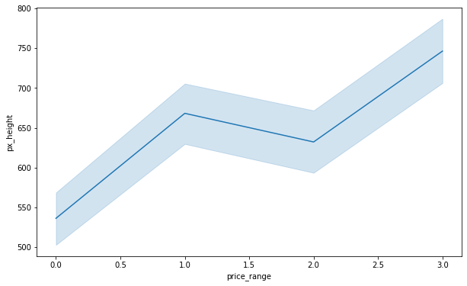
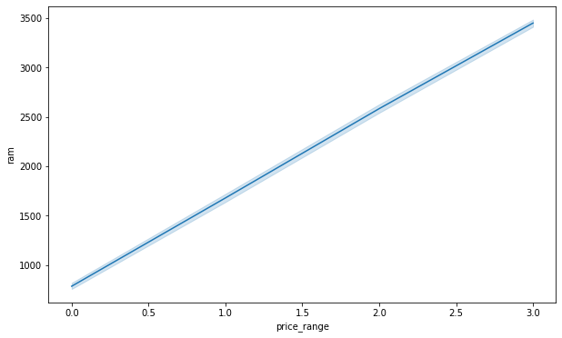
Let's Check Which Numerical Feature Is Driving The Price Range Most
Range 1 mobile price affected by Primary camera
Range 1 and range 3 mobile prices affected by mobile height
Ram affecting on all the range of mobiles as ram increases the price also increases.

Slide 19
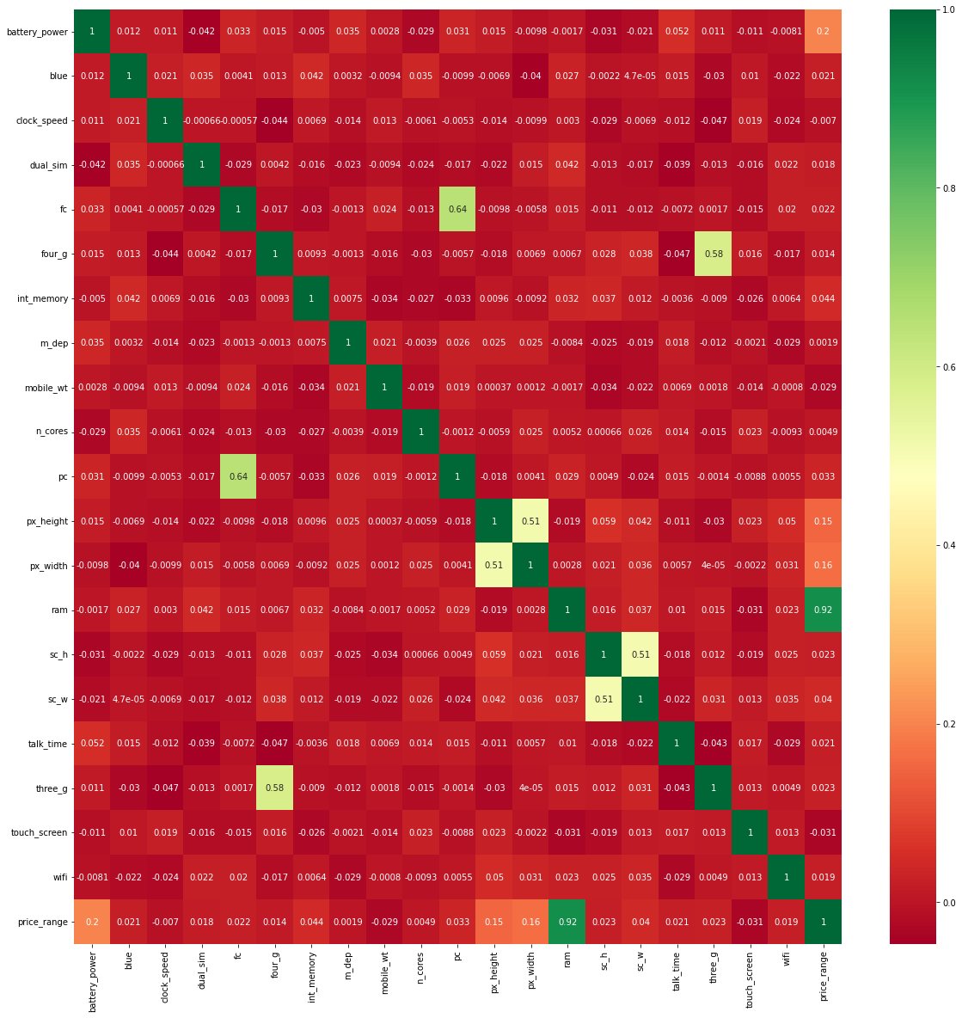
Correlation between parameters
Heat Map
Ram has the strongest positive correlation with mobile price.

Slide 20
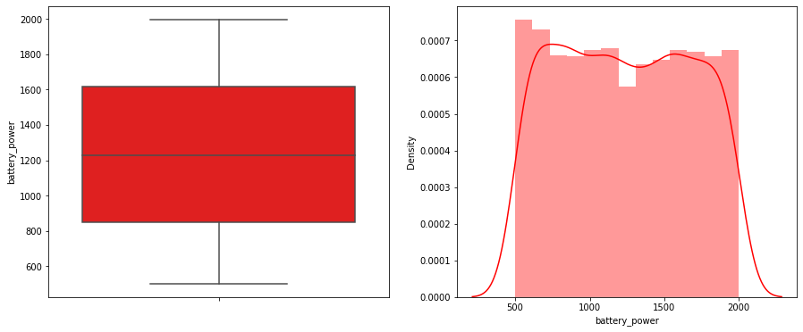
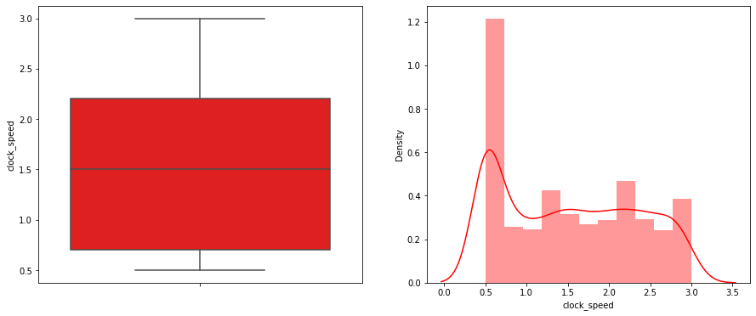
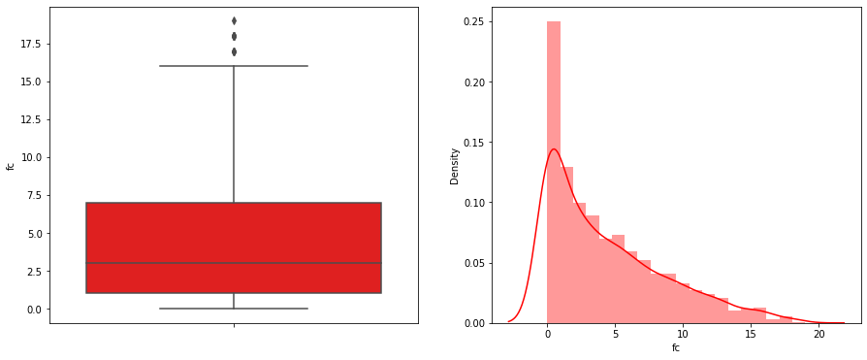
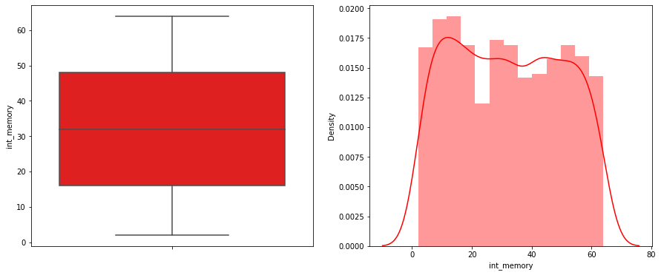
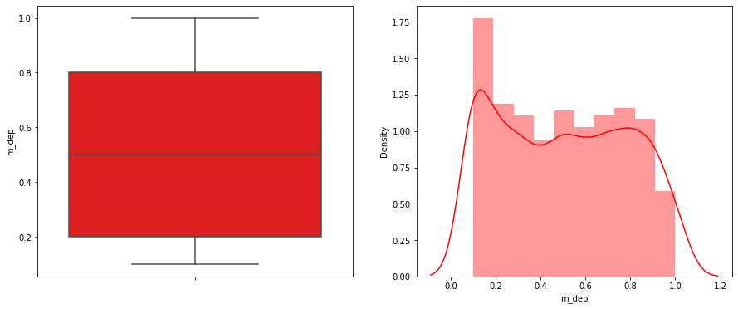
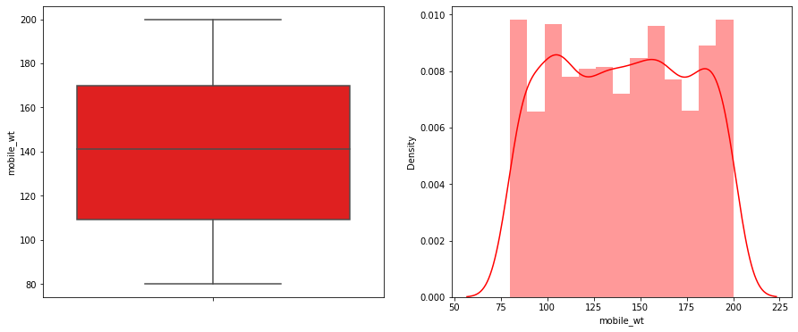
Check The Distribution Of Dataset

Slide 21
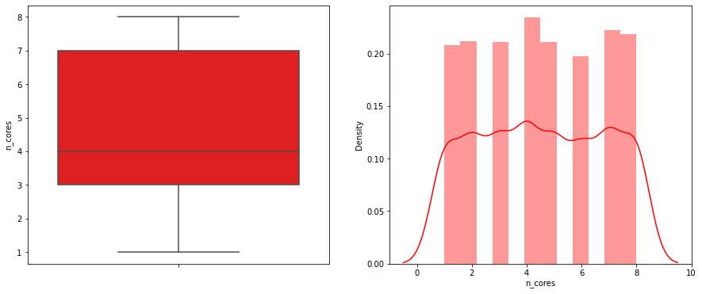
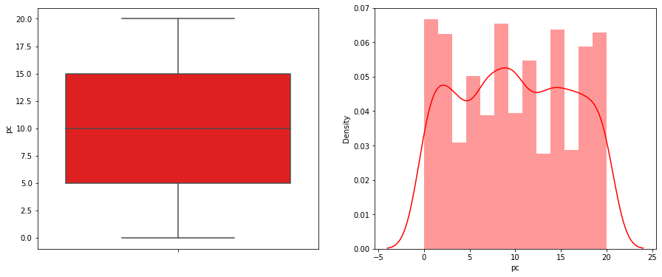
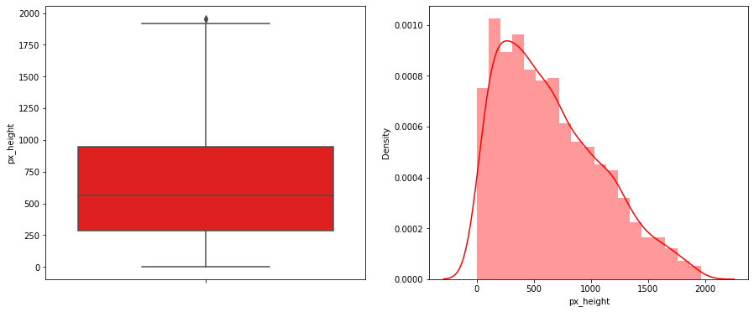
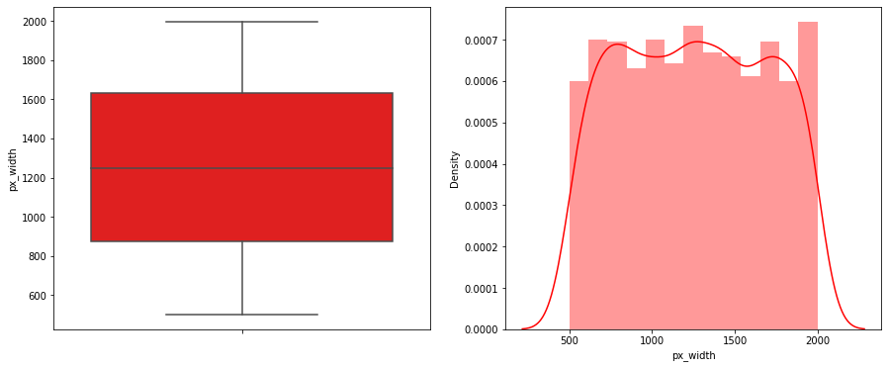
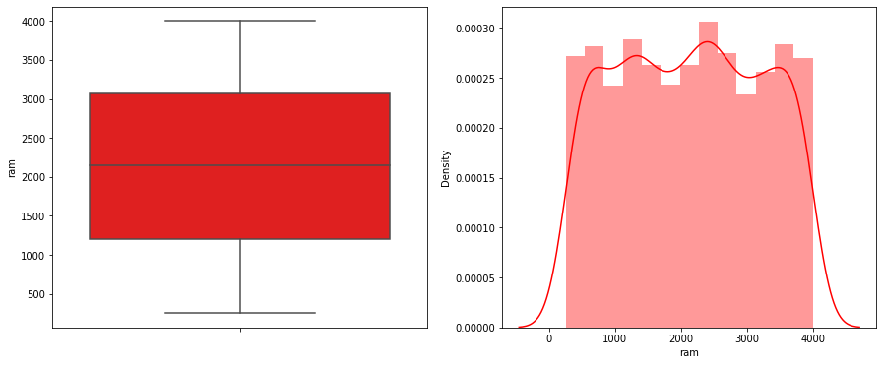
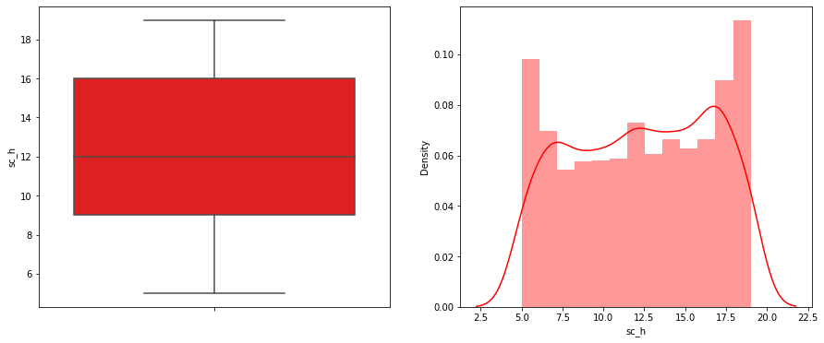
Check The Distribution Of Dataset

Slide 22
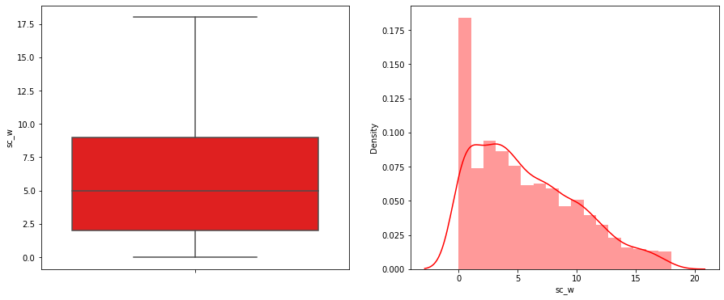
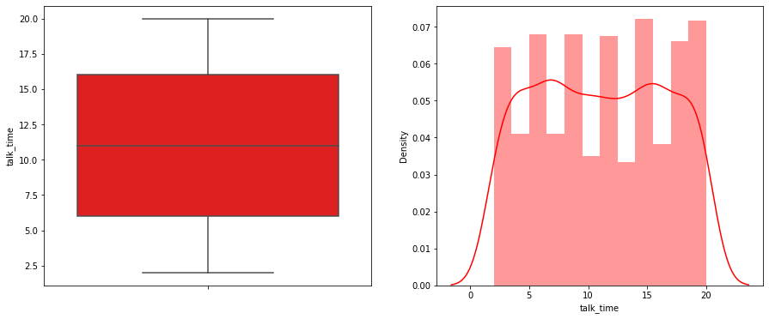
Check The Distribution Of Dataset
Data is well distrusted.
fc and px_height have some outliers.

Slide 23
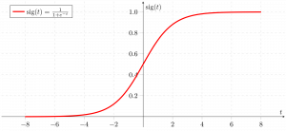
Machine Learning Algorithms
Logistic regression
accuracy of validation set 0.95
accuracy of the training set 0.97
accuracy of the test set 0.97

Slide 24
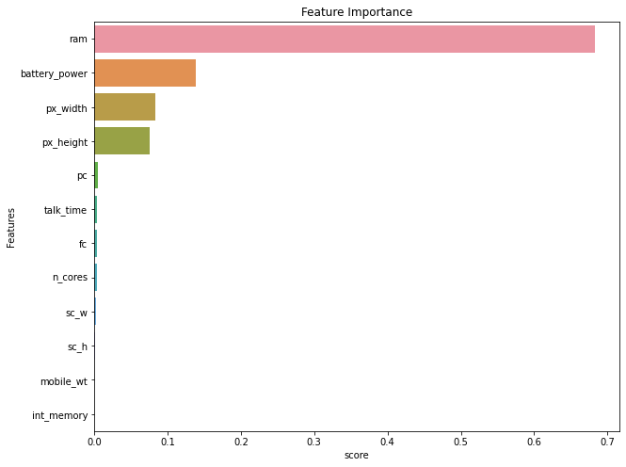
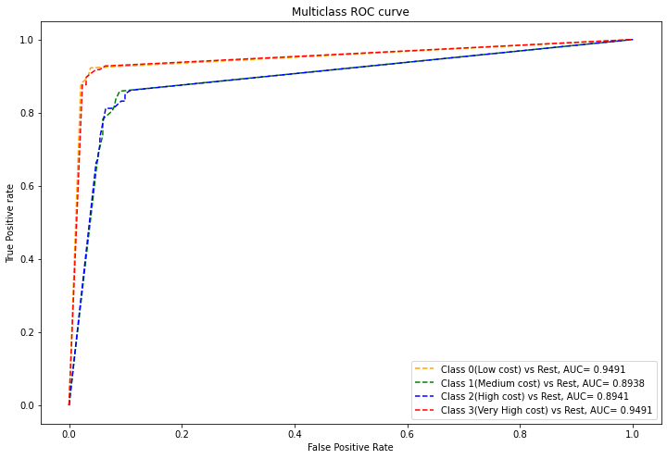
Decision Tree
Before hyper tuning
accuracy of validation set 0.85
accuracy of the training set 1.0
accuracy of the test set 0.83
After hyper tuning
accuracy of the training set 0.96
accuracy of the test set 0.84
OBSERVATION
Train accuracy has been reduced to 96% from 100% and test accuracy has increased by 1%. Thus, we somewhat reduced the overfitting by reducing the training accuracy. However, this will not be a good model for us.
RAM, battery power, px_height and width came out to be the most important features
This model classified class 0 and class 3 very nicely as we can see the AUC is almost 0.94 for both classes, whereas for class 1 and class 2 it is 0.84.

Slide 25
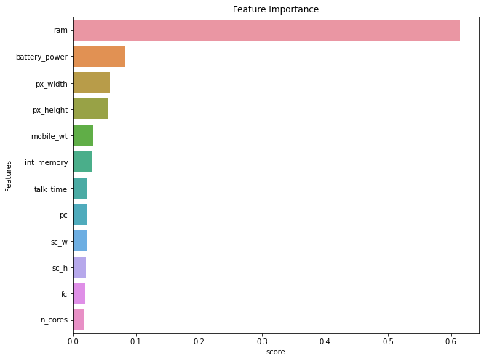
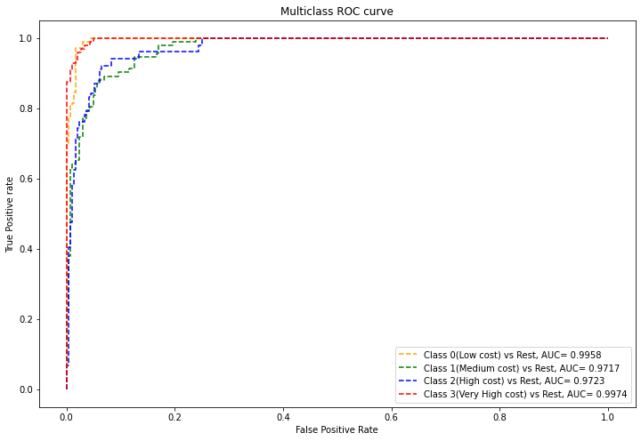
Random forest classifier
Observations of Random Forest:
Before Tuning
training accuracy = 100%
test accuracy = 88%
Model is overfitted the data and does not generalise well. So, we tuned the hyperparameters.
After tuning:
Training accuracy= 100%
Test accuracy = 90%
From the roc curve it’s clear that the model has poorly performed to classify class 1 and class 2.

Slide 26
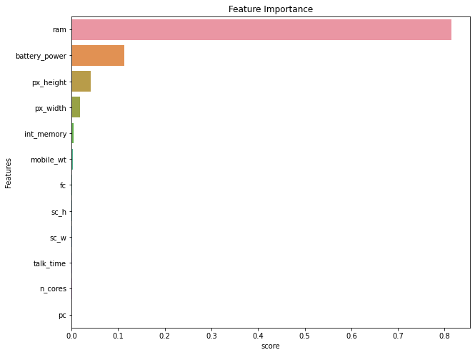
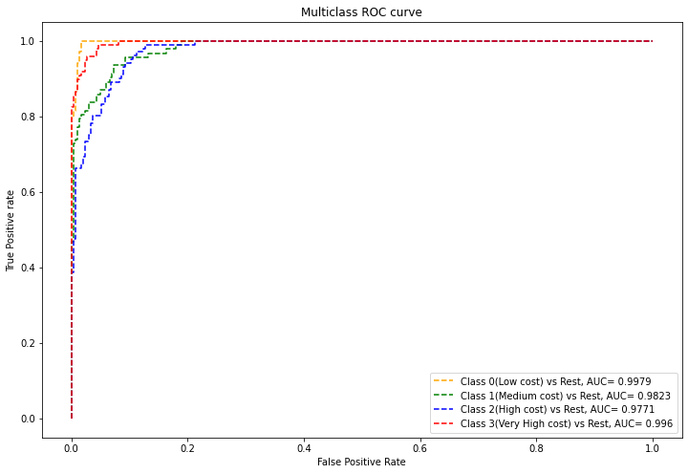
Gradient Boosting Classifier
Observations of Gradient Boost Classifiers:
Before Tuning
Train accuracy score= 100%.
Test accuracy score= 91%
Model did not generalise well and overfitted the training data. so, we tuned the hyperparameters of the model.
After Hyperparameter Tuning:
Train accuracy score= 100%
Test accuracy score=90%
Thus, we slightly improved the model performance. However, the model is not the best.

Slide 27
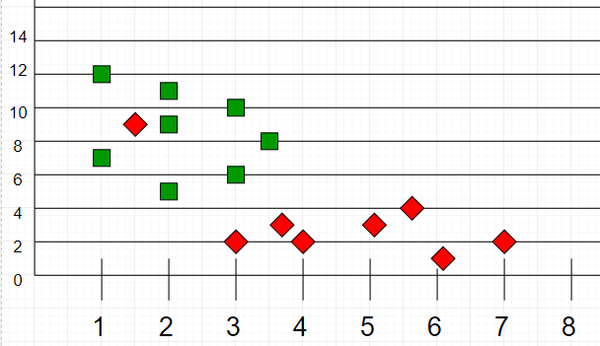
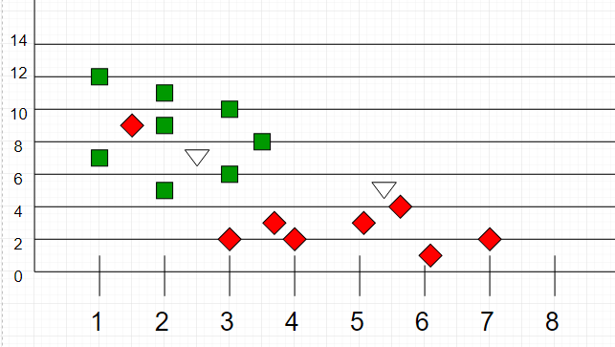
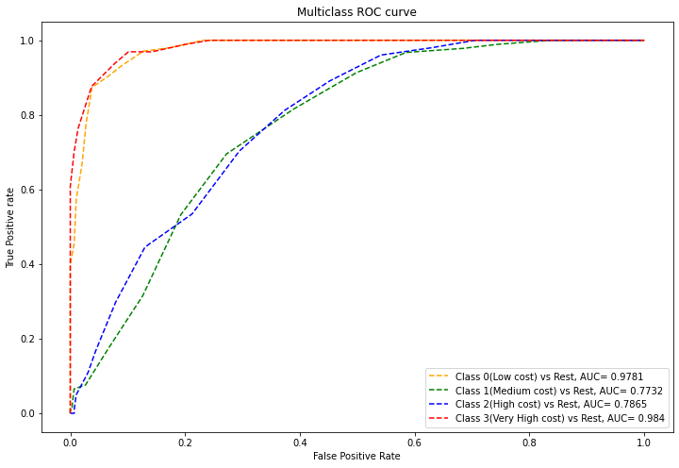
Nearest Neighbour
Observations:
Before hyperparameters tuning:
Train Accuracy:75 %
Test Accuracy:59 %
Clearly the Model has performed very poorly. We did hyperparameter tuning
After Hyperparameter Tuning:
Train Accuracy: 75%
Test Accuracy: 70%
Surely, we improved the model performance and reduced overfitting but however this is not a good model for us.

Slide 28
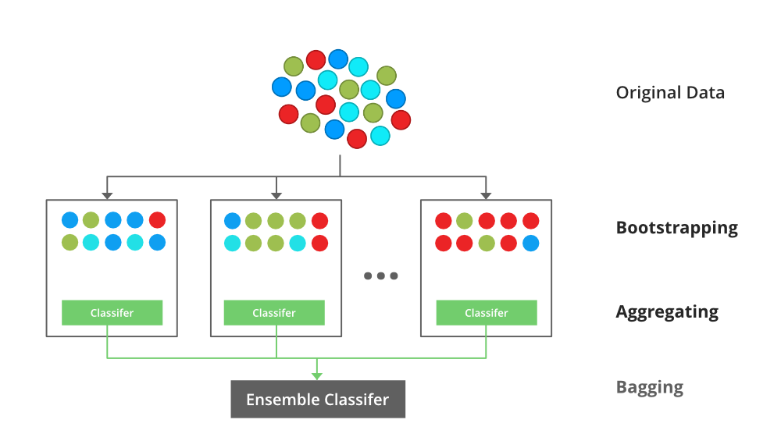
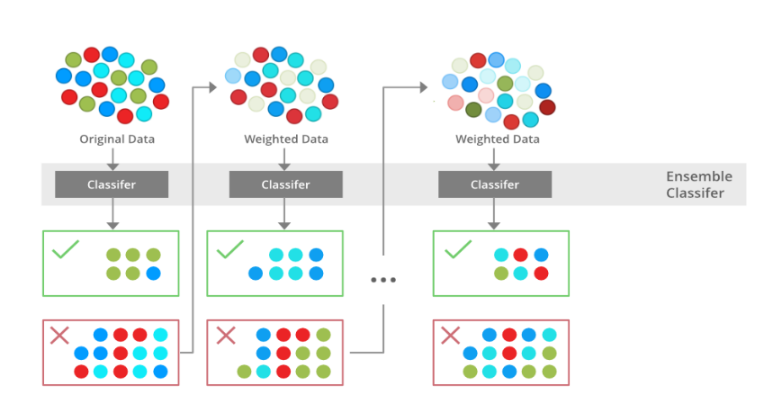


XGBooster
Observations
Before hyperparameter Tuning
Train Accuracy = 98%
Test Accuracy = 89%
After hyperparameter Tuning
Train Accuracy = 100%
Test Accuracy = 92%

Slide 29





Support Vector Machine (SVM)

Slide 30

Support Vector Machine (SVM)
Before hyper tuning
accuracy of validation set : 0.959848191937486
accuracy of the training set : 0.9783301465901848
accuracy of the testset: 0.9745547073791349
After hyper tuning
accuracy of the training set 0.982791586998088
accuracy of the testset 0.9745547073791349

Slide 31

Conclusion
SVM performed very well as compared to other algorithms.
In terms of feature importance RAM, Battery power, px_height and px_weight are the important features.
f1 score for individual classes is also very good. Area under the curve for each class prediction is also almost 1.
AS we can see SVM algorithm has highest accuracy which is 97%

